Slide 1

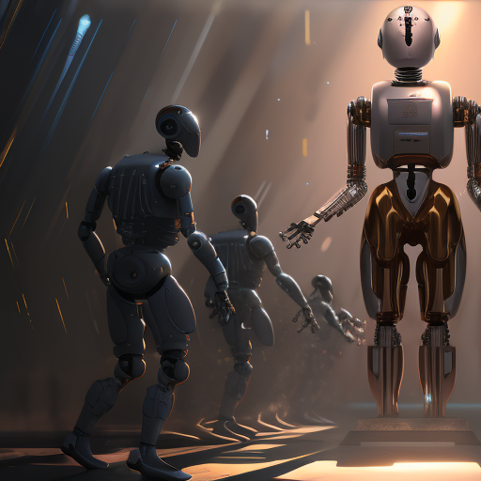
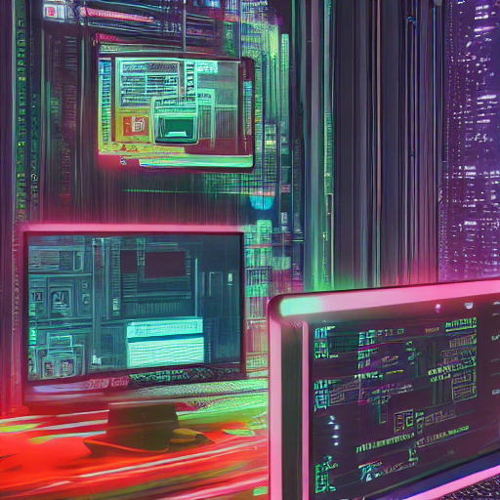
Software Engineering
WEEK 2
ENGR. Muhammad UMER HAROON

Slide 2
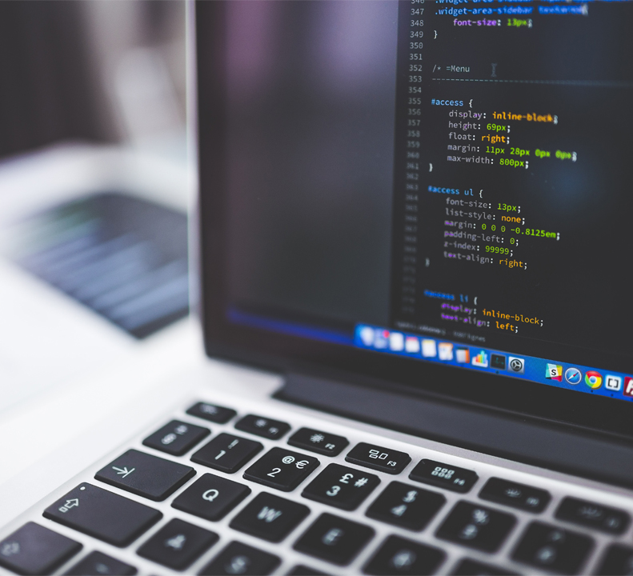
WEEK 2

Slide 3
The software process
A structured set of activities required to develop a software system.
Many different software processes but all involve:
Specification – defining what the system should do;
Design and implementation – defining the organization of the system and implementing the system;
Validation – checking that it does what the customer wants;
Evolution – changing the system in response to changing customer needs.
A software process model is an abstract representation of a process. It presents a description of a process from some particular perspective.

Slide 4
Software process descriptions
When we describe and discuss processes, we usually talk about the activities in these processes such as specifying a data model, designing a user interface, etc. and the ordering of these activities.
Process descriptions may also include:
Products, which are the outcomes of a process activity;
Roles, which reflect the responsibilities of the people involved in the process;
Pre- and post-conditions, which are statements that are true before and after a process activity has been enacted or a product produced.

Slide 5
Process VS Product
PROCESS
PRODUCT
"Software process" refers to the series of activities and tasks that are carried out to develop a software system. This includes activities such as requirements gathering, design, implementation, testing, and maintenance.
"Software product" refers to the end result of the software development process. It is the result of the software process, and it includes the source code, documentation, and other artifacts that make up the software system.

Slide 6
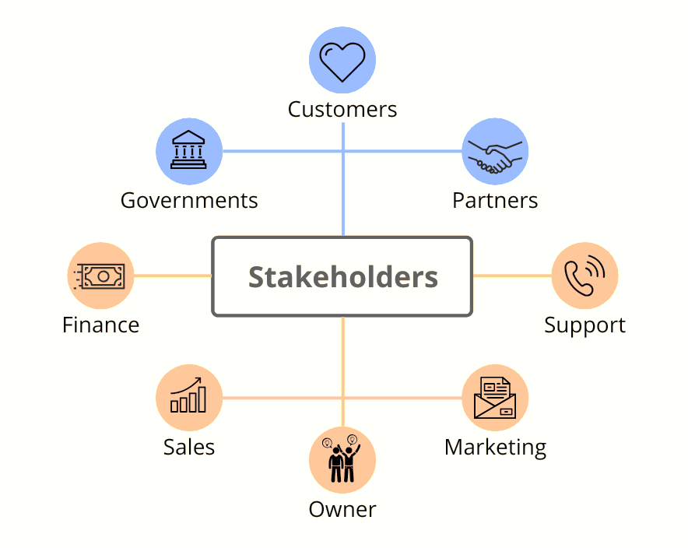

Slide 7
Plan-driven and agile processes
Plan-driven processes are processes where all of the process activities are planned in advance and progress is measured against this plan.
In agile processes, planning is incremental and it is easier to change the process to reflect changing customer requirements.
In practice, most practical processes include elements of both plan-driven and agile approaches.
There are no right or wrong software processes.

Slide 8
Software process models

Slide 9
Software process models
The waterfall model
Plan-driven model. Separate and distinct phases of specification and development.
Incremental development
Specification, development and validation are interleaved. May be plan-driven or agile.
Integration and configuration / Reuse
The system is assembled from existing configurable components. May be plan-driven or agile.
In practice, most large systems are developed using a process that incorporates elements from all of these models.

Slide 10
The waterfall model

Slide 11
Waterfall model phases
There are separate identified phases in the waterfall model:
Requirements analysis and definition
System and software design
Implementation and unit testing
Integration and system testing
Operation and maintenance
The main drawback of the waterfall model is the difficulty of accommodating change after the process is underway. In principle, a phase has to be complete before moving onto the next phase.

Slide 12
Waterfall model problems
Inflexible partitioning of the project into distinct stages makes it difficult to respond to changing customer requirements.
Therefore, this model is only appropriate when the requirements are well-understood and changes will be fairly limited during the design process.
Few business systems have stable requirements.
The waterfall model is mostly used for large systems engineering projects where a system is developed at several sites.
In those circumstances, the plan-driven nature of the waterfall model helps coordinate the work.

Slide 13
Incremental development

Slide 14
Incremental development benefits
The cost of accommodating changing customer requirements is reduced.
The amount of analysis and documentation that has to be redone is much less than is required with the waterfall model.
It is easier to get customer feedback on the development work that has been done.
Customers can comment on demonstrations of the software and see how much has been implemented.
More rapid delivery and deployment of useful software to the customer is possible.
Customers are able to use and gain value from the software earlier than is possible with a waterfall process.

Slide 15
Incremental development problems
The process is not visible.
Managers need regular deliverables to measure progress. If systems are developed quickly, it is not cost-effective to produce documents that reflect every version of the system.
System structure tends to degrade as new increments are added.
Unless time and money is spent on refactoring to improve the software, regular change tends to corrupt its structure. Incorporating further software changes becomes increasingly difficult and costly.

Slide 16
Integration and configuration
Based on software reuse where systems are integrated from existing components or application systems (sometimes called COTS -Commercial-off-the-shelf) systems).
Reused elements may be configured to adapt their behaviour and functionality to a user’s requirements
Reuse is now the standard approach for building many types of business system
Reuse covered in more depth in Chapter 15 in Sommerville book.

Slide 17
Types of reusable software
Stand-alone application systems (sometimes called COTS) that are configured for use in a particular environment.
Collections of objects that are developed as a package to be integrated with a component framework such as .NET or J2EE.
Web services that are developed according to service standards and which are available for remote invocation.

Slide 18
Reuse-oriented software engineering

Slide 19
Key process stages
Requirements specification
Software discovery and evaluation
Requirements refinement
Application system configuration
Component adaptation and integration

Slide 20
Advantages and disadvantages
Reduced costs and risks as less software is developed from scratch
Faster delivery and deployment of system
But requirements compromises are inevitable so system may not meet real needs of users
Loss of control over evolution of reused system elements

Slide 21
Process activities

Slide 22
Process activities
Real software processes are inter-leaved sequences of technical, collaborative and managerial activities with the overall goal of specifying, designing, implementing and testing a software system.
The four basic process activities of specification, development, validation and evolution are organized differently in different development processes.
For example, in the waterfall model, they are organized in sequence, whereas in incremental development they are interleaved.

Slide 23
The requirements engineering process

Slide 24
Software specification
The process of establishing what services are required and the constraints on the system’s operation and development.
Requirements engineering process
Requirements elicitation and analysis
What do the system stakeholders require or expect from the system?
Requirements specification
Defining the requirements in detail
Requirements validation
Checking the validity of the requirements

Slide 25
Software design and implementation
The process of converting the system specification into an executable system.
Software design
Design a software structure that realises the specification;
Implementation
Translate this structure into an executable program;
The activities of design and implementation are closely related and may be inter-leaved.

Slide 26
A general model of the design process

Slide 27
Design activities
Architectural design, where you identify the overall structure of the system, the principal components (subsystems or modules), their relationships and how they are distributed.
Database design, where you design the system data structures and how these are to be represented in a database.
Interface design, where you define the interfaces between system components.
Component selection and design, where you search for reusable components. If unavailable, you design how it will operate.

Slide 28
System implementation
The software is implemented either by developing a program or programs or by configuring an application system.
Design and implementation are interleaved activities for most types of software system.
Programming is an individual activity with no standard process.
Debugging is the activity of finding program faults and correcting these faults.

Slide 29
Software validation
Verification and validation (V & V) is intended to show that a system conforms to its specification and meets the requirements of the system customer.
Involves checking and review processes and system testing.
System testing involves executing the system with test cases that are derived from the specification of the real data to be processed by the system.
Testing is the most commonly used V & V activity.

Slide 30
Stages of testing

Slide 31
Testing stages
Component testing
Individual components are tested independently;
Components may be functions or objects or coherent groupings of these entities.
System testing
Testing of the system as a whole. Testing of emergent properties is particularly important.
Customer testing
Testing with customer data to check that the system meets the customer’s needs.

Slide 32
Testing phases in a plan-driven software process (V-model)

Slide 33
Software evolution
Software is inherently flexible and can change.
As requirements change through changing business circumstances, the software that supports the business must also evolve and change.
Although there has been a demarcation between development and evolution (maintenance) this is increasingly irrelevant as fewer and fewer systems are completely new.[talking :legacy systems]

Slide 34
System evolution

Slide 35

Second Week Summary
Here is what we learned

Slide 36
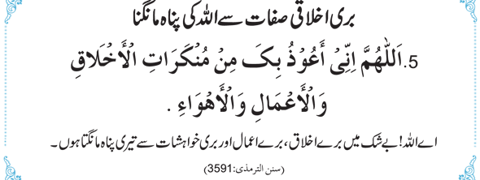
Thank You!

